Slide 1
The R Training Curriculum
R101 | Session 1| Introduction to R
Prepared for ZS Associates
New Delhi | +91 124 679 7000

Slide 2
This course consists of four modules:
Basics of R Language
Programming in R
Data Management in R
Data Visualization in R

Slide 3
By the end of this course, you will be able to:
Write and execute basic programs in R language
Understand and use the data structures in R
Read and write data from files
Use various programming structures in R
Wrangle data with R
Explore data using R
Create data visualization in R
Understand and run some useful models with R

Slide 4
Some pre-requisites
Install R 3.2.4
Install R-studio 0.99
Download Course Materials
An R Project folder is available at:
<\\de-util01\Hold\Nishant_Gupta\R Session>

Slide 5

What is R?
R Base:
A Statistical Programming Language
Open-source GPL1
Functional Nature
Rich Data Structures
Powerful Visualizations
+
R can be extended (easily!) via 7700+ Contributed Packages or Extensions
Data Management
Data Visualization
Data Products
Modeling and Simulation
dplyr
ggplot2
shiny
MASS
forecast
tidyr
ggvis
slidify
party
clusterify
foreign
lattice
knitr
nlme
bootstrap
haven
igraph
rmarkdown
ROCR
broom

Slide 6

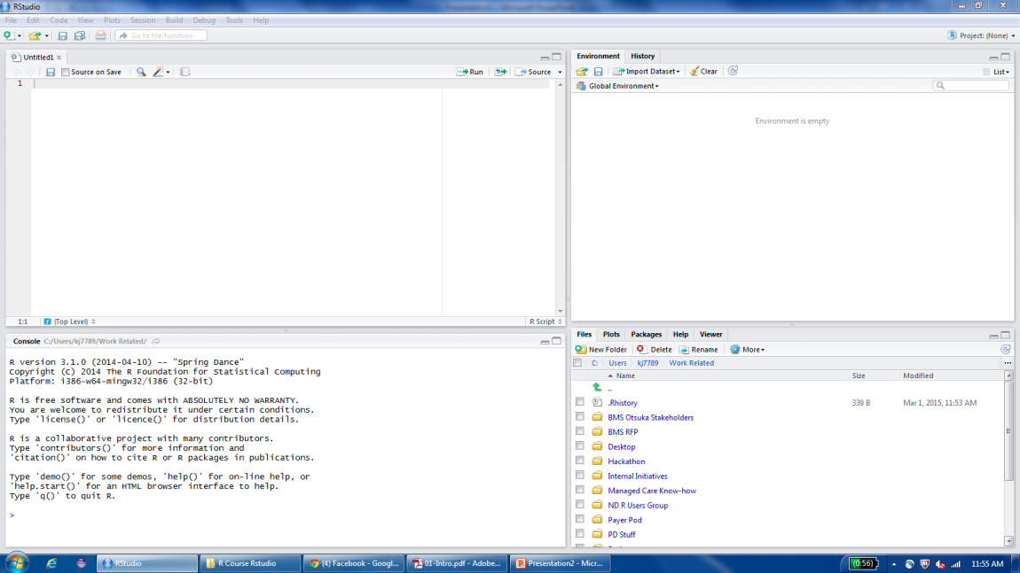
What is R-studio?
A Powerful Integrated Development Environment (IDE) for R & much more…
Text editor, version control, latex integration, keyboard shortcuts, debugging tools, and much more

Slide 7
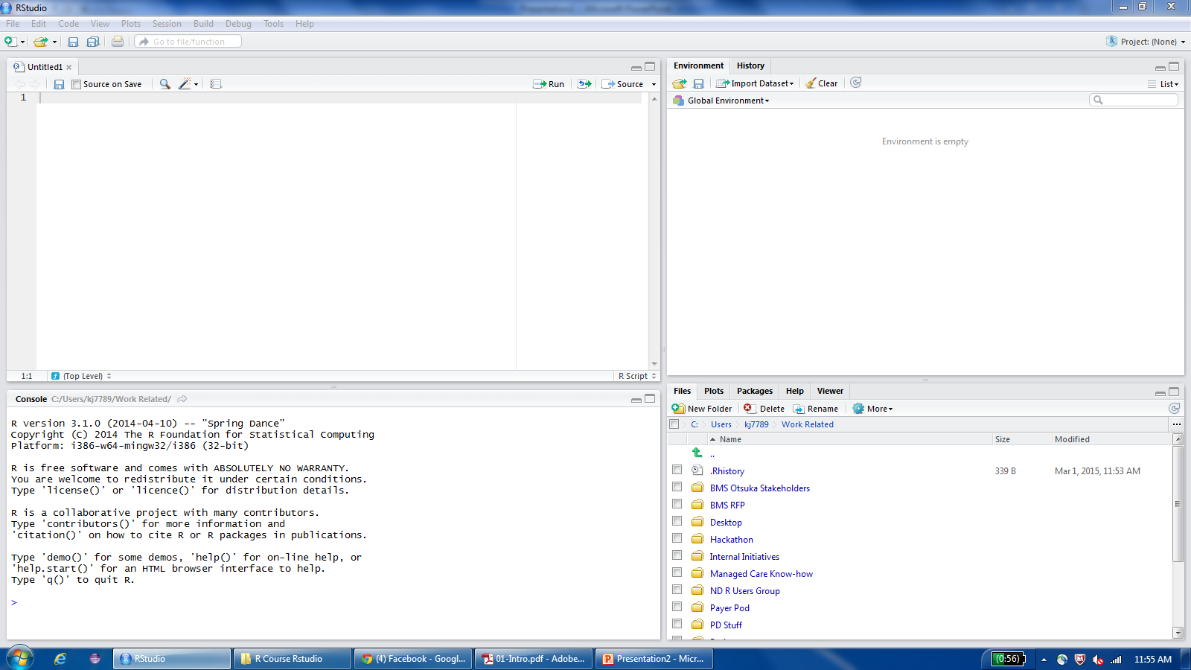
Script Editor / Viewing Pane
1
This is the script editor where you write codes

Slide 8
R Console – Allows interactive analytics
2
This is the console where you can type commands and see output.
A place to execute commands written in the R computer language

Slide 9
Environment / History Pane
3
Here you view variables in workspace and history files

Slide 10
Multi-purpose Pane (File Browser, Plots, Help, etc.)
4
Displays files, plots (graphs); manages packages and displays help topics

Slide 11
Try the following commands…
demo(persp)
demo(graphics)
rm(list = ls())
Press Ctrl + L

Slide 12
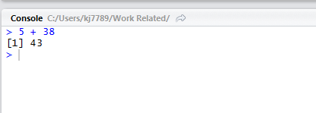
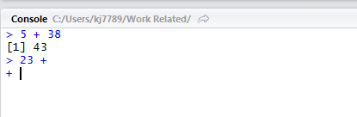
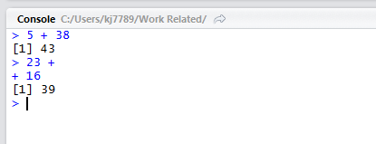
Command Prompt
Type your instructions / code after the command prompt (“>”) and press “Enter”
General convention in R is to type one complete instruction in one line
Command prompt changes to “+” symbol in case incomplete instruction is entered
Just complete the command at “+” prompt and press enter

Slide 13
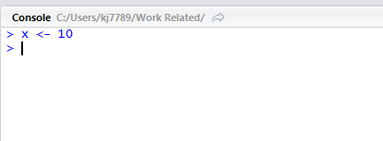
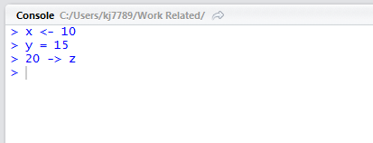
Creating Variables
Create a new variable “x” with a value of 10
Assignment Operator in R is “<-”
You may also use “=“ for assignments
To right assign values to variables in R
“->”
As a matter of convention, most R programmers use “<-” as the assignment operator and is recommended for you as well

Slide 14
What is the data type of the following?
31
108.5
“ZS”
TRUE
3 + 5i

Slide 15
Do you agree?
31
108.5
“ZS”
TRUE
3 + 5i
Integer
Numeric
Character
Logical
Complex

Slide 16
How to define in R?
31
108.5
“ZS”
TRUE
3 + 5i
Integer
Numeric
Character
Logical
Complex
X <- 31L
X <- 108.5
X <- “ZS”
X <- TRUE
X <- 3 + 5i

Slide 17
You could also define this way
31
108.5
“ZS”
TRUE
3 + 5i
Integer
Numeric
Character
Logical
Complex
X <- 31L
X <- 108.5
X <- “ZS”
X <- TRUE
X <- 3 + 5i
X <- ‘ZS’
X <- T
X <- (5 < 6)
To define a logical variables, valid values are:
TRUE
FALSE
T
F
Or any logical expression that evaluated to a TRUE or FALSE

Slide 18
Watch out for the following common mistakes
31
108.5
“ZS”
TRUE
3 + 5i
Integer
Numeric
Character
Logical
Complex
X <- 31L
X <- 108.5
X <- “ZS”
X <- TRUE
X <- 3 + 5i
X <- ‘ZS’
X <- T
X <- (5 < 6)
X <- ZS
X <- True
X <- true

Slide 19
Use class(x) to find out the class of x variable
31
108.5
“ZS”
TRUE
3 + 5i
Integer
Numeric
Character
Logical
Complex
X <- 31L
X <- 108.5
X <- “ZS”
X <- TRUE
X <- 3 + 5i
X <- ‘ZS’
X <- T
X <- (5 < 6)
X <- ZS
X <- True
X <- true
[1] “integer”
[1] “numeric”
[1] “character”
[1] “logical”
[1] “complex”
R supports all of the above 5 types of atomic data types

Slide 20
Special Values in R
NA
NaN
Inf, -Inf
Not Available
Not a Number
Infinity
is.na(x)
is.nan(x)
is.infinite(x)
R supports all of the above 5 types of atomic data types

Slide 21
What if you want to store more than one data point in a single variable? What would you call this type?
31 35 190 299 21 10 40 26 534

Slide 22
Vectors are the most basic data structure in R
31 35 190 299 21 10 40 26 534
Vector
A vector can hold data of a single type. Hence the vector can be of the following classes:
Numeric
Integer
Character
Logical
Complex
How many dimensions are there in a vector?
Can you guess what is a single element vector called?
In R, all scalars are essentially single element vectors. Hence there are no true scalars in the world of R

Slide 23
Ways to create a vector?
vec1 <- c(‘kapil’, ‘nishant’, ‘aritra’) # Use c(), i.e., concatenate function
vec2 <- 1:10 # Use : operator, i.e., ‘to’ operator
vec3 <- seq(1, 10) # Creates a sequence
vec4 <- rep(5, 10) # Repeats a number many times
vec5 <- (vec4 > 8) # Creates a logical vector of length 6 with TRUE wherever vec4 elements are above 8

Slide 24

What is the class of the following vector?
Data Types

Slide 25

Be aware of the side-effects of mixing and matching among various types of data
Data Types
Character
R will “coerce” all the data points to be of the most “rigid” type

Slide 26
Coercion in R tries to retain maximum possible information by choosing a class as below
Character
Logical
Numeric
Integer

Slide 27
Manual Coercion
Data Types
Function | Coerces x to be:
as.numeric(x) | Numeric
as.integer(x) | Integer
as.character(x) | Character
as.logical(x) | Logical
Examples:
as.numeric(“1”)
as.character(TRUE)

Slide 28
Vector Operations
vec1 <- 1:10
vec2 <- 11:20
vec3 <- vec1 + vec2
vec3 <- vec1 * vec2
vec1 | vec2 | vec3
1 | 11 | 12
2 | 12 | 14
3 | 13 | 16
4 | 14 | 18
5 | 15 | 20
6 | 16 | 22
7 | 17 | 24
8 | 18 | 26
9 | 19 | 28
10 | 20 | 30
vec1 | vec2 | vec3
1 | 11 | 11
2 | 12 | 24
3 | 13 | 39
4 | 14 | 56
5 | 15 | 75
6 | 16 | 96
7 | 17 | 119
8 | 18 | 144
9 | 19 | 171
10 | 20 | 200
R performs vector operations in a “vectorized” or element by element manner

Slide 29
What will happen in the case presented below? Any guesses?
vecA <- 1:10
vecB <- 11:15
vecC <- vecA + vecB
vecA | vecB | vecC
1 | 11 | ?
2 | 12 | ?
3 | 13 | ?
4 | 14 | ?
5 | 15 | ?
6 |  | ?
7 |  | ?
8 |  | ?
9 |  | ?
10 |  | ?

Slide 30
Can you try following code in console and see the values of vecC?
vecA <- 1:10
vecB <- 11:15
vecC <- vecA + vecB
vecA | vecB | vecC
1 | 11 | ?
2 | 12 | ?
3 | 13 | ?
4 | 14 | ?
5 | 15 | ?
6 |  | ?
7 |  | ?
8 |  | ?
9 |  | ?
10 |  | ?
vecA | vecB | vecC
1 | 11 | 12
2 | 12 | 14
3 | 13 | 16
4 | 14 | 18
5 | 15 | 20
6 | ? | 17
7 | ? | 19
8 | ? | 21
9 | ? | 23
10 | ? | 25

Slide 31
R uses “recycling” for vector operations
vecA <- 1:10
vecB <- 11:15
vecC <- vecA + vecB
R recycles the smaller vector to be of the length of the larger vector and performs vector operations
vecA | vecB | vecC
1 | 11 | ?
2 | 12 | ?
3 | 13 | ?
4 | 14 | ?
5 | 15 | ?
6 |  | ?
7 |  | ?
8 |  | ?
9 |  | ?
10 |  | ?
vecA | vecB | vecC
1 | 11 | 12
2 | 12 | 14
3 | 13 | 16
4 | 14 | 18
5 | 15 | 20
6 | ? | 17
7 | ? | 19
8 | ? | 21
9 | ? | 23
10 | ? | 25
vecA | vecB | vecC
1 | 11 | 12
2 | 12 | 14
3 | 13 | 16
4 | 14 | 18
5 | 15 | 20
6 | 11 | 17
7 | 12 | 19
8 | 13 | 21
9 | 14 | 23
10 | 15 | 25

Slide 32
Recycling is a very powerful concept as it “vectorizes” operations on vectors
vecA <- 1:10
vecB <- 4
vecC <- vecA + vecB
vecA <- 1:10
vecB <- c(21, 48)
vecC <- vecA + vecB
vecA <- 1:10
vecB <- c(5, 10, 15)
vecC <- vecA + vecB
vecA | vecB | vecC
1 | 4 | 5
2 | 4 | 6
3 | 4 | 7
4 | 4 | 8
5 | 4 | 9
6 | 4 | 10
7 | 4 | 11
8 | 4 | 12
9 | 4 | 13
10 | 4 | 14
vecA | vecB | vecC
1 | 21 | 22
2 | 48 | 50
3 | 21 | 24
4 | 48 | 52
5 | 21 | 26
6 | 48 | 54
7 | 21 | 28
8 | 48 | 56
9 | 21 | 30
10 | 48 | 58
vecA | vecB | vecC
1 | 5 | ?
2 | 10 | ?
3 | 15 | ?
4 |  | ?
5 |  | ?
6 |  | ?
7 |  | ?
8 |  | ?
9 |  | ?
10 |  | ?
Your Turn

Slide 33
What to do if you want to extract a subset of a vector?
vec <- 1:10
vec[ ? ]
Position of the element in vec
Vector containing positions of all elements to be extracted from vec
Logical vector of length equal to the length of the vec itself, with TRUE for each element to be extracted FALSE otherwise
vec[5] will return 5
vec[7] will return ?
vec[0] will return ?
vec[-5] will return ?
vec[2:5] will return 2 3 4 5
vec[c(3, 6)] will return ?
vec[-6:-3] will return ?
vec[c(3, -5)] will return ?
vec[c(TRUE, FALSE)] will return ?

Slide 34
Since a vector can be indexed using a logical vector, this enables us to do interesting things
vec[vec > 10] ?
vec[vec <= 12] ?
vec[vec == 9] ?
vec[vec != 8] ?
vec[vec %in% c(10, 5, 7)] ?
vec[vec > 7 & vec < 12] ?
vec[vec > 10 | vec == 7] ?
vec[!(vec > 8)] ?
Define a vector as below
vec <- 5:14
What will the following statements return?

Slide 35
Some Helpful Functions for Vectors
x <- c(1, 2, 3, 4, 5, 6,7,8, 9, NA)
is.finite(x)
any(x < 0)
all(x > 5)
Returns FALSE for NA, NaN, Inf or -Inf
Returns TRUE if any of the element in the vector satisfies the condition
Returns TRUE if all of the element in the vector satisfies the condition
Important Tip
any(x > 0, na.rm = TRUE)
“na.rm = TRUE” ignores the NAs in the vector
To check for any NAs in a vector x: any(is.na(x))

Slide 36
What is a two-dimensional vector called?
5 | 9 | 13 | 17
6 | 10 | 14 | 18
7 | 11 | 15 | 19
8 | 12 | 16 | 20

Slide 37
A Matrix
5 | 9 | 13 | 17
6 | 10 | 14 | 18
7 | 11 | 15 | 19
8 | 12 | 16 | 20
In R, just like a vector, a matrix can hold data of a single type

Slide 38
Defining and slicing matrices
5 | 9 | 13 | 17
6 | 10 | 14 | 18
7 | 11 | 15 | 19
8 | 12 | 16 | 20
Which element is M₃₄?

Slide 39
Defining and slicing matrices
5 | 9 | 13 | 17
6 | 10 | 14 | 18
7 | 11 | 15 | 19
8 | 12 | 16 | 20
Which element is M₃₄?

Slide 40
Defining and slicing matrices
In R:
5 | 9 | 13 | 17
6 | 10 | 14 | 18
7 | 11 | 15 | 19
8 | 12 | 16 | 20
> mat <- matrix(5:20, nrow = 4)
> mat[3, 4]
[1] 19
matrix() function is used to create a matrix in R.
nrow parameter specifies the number of rows in the matrix
Which element is M₃₄?
mat[ ?, ? ]
The row index
The column index
Separate dimensions with a comma

Slide 41
Defining and slicing matrices
In R:
5 | 9 | 13 | 17
6 | 10 | 14 | 18
7 | 11 | 15 | 19
8 | 12 | 16 | 20
> mat <- matrix(5:20, nrow = 4)
> mat[3, 4]
[1] 19
matrix() function is used to create a matrix in R.
nrow parameter specifies the number of rows in the matrix
Which element is M₃₄?
5 | 9 | 13 | 17
6 | 10 | 14 | 18
7 | 11 | 15 | 19
8 | 12 | 16 | 20
How to extract second column?

Slide 42
Defining and slicing matrices
In R:
5 | 9 | 13 | 17
6 | 10 | 14 | 18
7 | 11 | 15 | 19
8 | 12 | 16 | 20
> mat <- matrix(5:20, nrow = 4)
> mat[3, 4]
[1] 19
matrix() function is used to create a matrix in R.
nrow parameter specifies the number of rows in the matrix
Which element is M₃₄?
5 | 9 | 13 | 17
6 | 10 | 14 | 18
7 | 11 | 15 | 19
8 | 12 | 16 | 20
In R:
> mat[ , 2]
[1] 9 10 11 12
A blank index (row or column) will select the all rows or columns
How to extract second column?

Slide 43
Matrix slicing using vectors
5 | 9 | 13 | 17
6 | 10 | 14 | 18
7 | 11 | 15 | 19
8 | 12 | 16 | 20
How to select the above sub-matrix?

Slide 44
Matrix slicing using vectors
In R:
5 | 9 | 13 | 17
6 | 10 | 14 | 18
7 | 11 | 15 | 19
8 | 12 | 16 | 20
> mat[2:3, 3:4]
[,1] [,2]
[1,] 14 18
[2,] 15 19
You can pass a vector as an index as well
How to select the above sub-matrix?

Slide 45
Matrix slicing using vectors
In R:
5 | 9 | 13 | 17
6 | 10 | 14 | 18
7 | 11 | 15 | 19
8 | 12 | 16 | 20
> mat[2:3, 3:4]
[,1] [,2]
[1,] 14 18
[2,] 15 19
You can pass a vector as an index as well
How to select the above sub-matrix?
In R:
5 | 9 | 13 | 17
6 | 10 | 14 | 18
7 | 11 | 15 | 19
8 | 12 | 16 | 20
> ???
[,1] [,2]
[1,] 9 17
[2,] 10 18
[3,] 11 19
[4,] 12 20
Your Turn
Remember we can pass a vector as an index as well

Slide 46
A vector can hold data of only one type
Lists
Vector | “Charu” | “23” | “F” | “FALSE”

Slide 47
However, a list can hold data of any type
Lists
Vector | “Charu” | “23” | “F” | “FALSE”
character
List | “Charu” | 23 | “F” | FALSE
character
numeric
character
logical

Slide 48
Or even more complex data types
Lists
Vector | “Charu” | “23” | “F” | “FALSE”
character
List | “Charu” | 23 | “F” | FALSE
character
numeric
character
logical
List | c(1, 2) | 1 1 2 3 | “F” | List B
vector
matrix
character
list
The elements of a list can be anything. Even vectors or other lists.

Slide 49
Creating a list
> nam <- c(“Kapil”, ”Nishant”, ”Aritra”, “Charu”) > age <- c(31, 25, 29, 23) > sex <- c(“M”, “M”, “M”, “F”)
> train <- c(TRUE, TRUE, FALSE, FALSE) > test <- list(name = nam, age = age, sex = sex, tainer = train)
R stores these as names of each element of the list
name
age
sex
trainer
test | “Kapil” “Nishant” “Aritra” “Charu” | 31 25 29 23 | “M” “M” “M” “F” | TRUE TRUE FALSE FALSE

Slide 50
Subsetting a list
name
age
sex
trainer
test | “Kapil” “Nishant” “Aritra” “Charu” | 31 25 29 23 | “M” “M” “M” “F” | TRUE TRUE FALSE FALSE
list[ ? ]
Position of Element
> test[2]
age
Still a list;
class() ?
test | 31 25 29 23

Slide 51
Subsetting a list
name
age
sex
trainer
test | “Kapil” “Nishant” “Aritra” “Charu” | 31 25 29 23 | “M” “M” “M” “F” | TRUE TRUE FALSE FALSE
list[ ? ]
list[[ ? ]]
Position of Element
Position of Element
> test[2]
> test[[2]]
age
Now it is a vector;
class() ?
test | 31 25 29 23
age | 31 25 29 23

Slide 52
Subsetting a list
name
age
sex
trainer
test | “Kapil” “Nishant” “Aritra” “Charu” | 31 25 29 23 | “M” “M” “M” “F” | TRUE TRUE FALSE FALSE
list[ ? ]
list[[ ? ]]
list$var
Also called slotting operator
Name of the element
Position of Element
Position of Element
> test[2]
> test[[2]]
> test$var
age
This too is a vector;
class() ?
test | 31 25 29 23
age | 31 25 29 23
age | 31 25 29 23

Slide 53
What if you want to store data of various types in a single data structure?
matrix
Name | Age | Sex | R-trainer?
“Kapil” | “31” | “M” | “TRUE”
“Nishant” | “25” | “M” | “TRUE”
“Aritra” | “29” | “M” | “FALSE”
“Charu” | “23” | “F” | “FALSE”
character

Slide 54
Name column is a character
matrix
Name | Age | Sex | R-trainer?
“Kapil” | “31” | “M” | “TRUE”
“Nishant” | “25” | “M” | “TRUE”
“Aritra” | “29” | “M” | “FALSE”
“Charu” | “23” | “F” | “FALSE”
Name
“Kapil”
“Nishant”
“Aritra”
“Charu”
character
character

Slide 55
Age column is a numeric
matrix
Name | Age | Sex | R-trainer?
“Kapil” | “31” | “M” | “TRUE”
“Nishant” | “25” | “M” | “TRUE”
“Aritra” | “29” | “M” | “FALSE”
“Charu” | “23” | “F” | “FALSE”
Name | Age
“Kapil” | 31
“Nishant” | 25
“Aritra” | 29
“Charu” | 23
character
character
numeric

Slide 56
Sex column is a character again
matrix
Name | Age | Sex | R-trainer?
“Kapil” | “31” | “M” | “TRUE”
“Nishant” | “25” | “M” | “TRUE”
“Aritra” | “29” | “M” | “FALSE”
“Charu” | “23” | “F” | “FALSE”
Name | Age | Sex
“Kapil” | 31 | “M”
“Nishant” | 25 | “M”
“Aritra” | 29 | “M”
“Charu” | 23 | “F”
character
character
numeric
character

Slide 57
R-trainer column is a logical
matrix
Name | Age | Sex | R-trainer?
“Kapil” | “31” | “M” | “TRUE”
“Nishant” | “25” | “M” | “TRUE”
“Aritra” | “29” | “M” | “FALSE”
“Charu” | “23” | “F” | “FALSE”
Name | Age | Sex | R-trainer?
“Kapil” | 31 | “M” | TRUE
“Nishant” | 25 | “M” | TRUE
“Aritra” | 29 | “M” | FALSE
“Charu” | 23 | “F” | FALSE
character
character
numeric
character
logical

Slide 58
There is no data structure in R that can hold this type of data
matrix
Name | Age | Sex | R-trainer?
“Kapil” | “31” | “M” | “TRUE”
“Nishant” | “25” | “M” | “TRUE”
“Aritra” | “29” | “M” | “FALSE”
“Charu” | “23” | “F” | “FALSE”
Name | Age | Sex | R-trainer?
“Kapil” | 31 | “M” | TRUE
“Nishant” | 25 | “M” | TRUE
“Aritra” | 29 | “M” | FALSE
“Charu” | 23 | “F” | FALSE
character
character
numeric
character
logical

Slide 59
☺ ☺ ☺
matrix
Data frame
Name | Age | Sex | R-trainer?
“Kapil” | “31” | “M” | “TRUE”
“Nishant” | “25” | “M” | “TRUE”
“Aritra” | “29” | “M” | “FALSE”
“Charu” | “23” | “F” | “FALSE”
Name | Age | Sex | R-trainer?
“Kapil” | 31 | “M” | TRUE
“Nishant” | 25 | “M” | TRUE
“Aritra” | 29 | “M” | FALSE
“Charu” | 23 | “F” | FALSE
character
character
numeric
character
logical
Each column in a data frame can be a different type.

Slide 60
A data frame consists of variables (columns)…
Data frame
Name | Age | Sex | R-trainer?
“Kapil” | 31 | “M” | TRUE
“Nishant” | 25 | “M” | TRUE
“Aritra” | 29 | “M” | FALSE
“Charu” | 23 | “F” | FALSE
character
numeric
character
logical

Slide 61
…and observations (rows)
Data frame
Name | Age | Sex | R-trainer?
“Kapil” | 31 | “M” | TRUE
“Nishant” | 25 | “M” | TRUE
“Aritra” | 29 | “M” | FALSE
“Charu” | 23 | “F” | FALSE
character
numeric
character
logical

Slide 62
Creating a data frame
> nam <- c(“Kapil”, ”Nishant”, ”Aritra”, “Charu”) > age <- c(31, 25, 29, 23) > sex <- c(“M”, “M”, “M”, “F”)
> train <- c(TRUE, TRUE, FALSE, FALSE) > test <- data.frame(name = nam, age = age, sex = sex, tainer = train)
name | age | sex | trainer
“Kapil” | 31 | “M” | TRUE
“Nishant” | 25 | “M” | TRUE
“Aritra” | 29 | “M” | FALSE
“Charu” | 23 | “F” | FALSE
R stores these as names of each column in the data frame
You can access these names by using names(test)
character
numeric
character
logical

Slide 63
Subsetting a data frame
name | age | sex | trainer
“Kapil” | 31 | “M” | TRUE
“Nishant” | 25 | “M” | TRUE
“Aritra” | 29 | “M” | FALSE
“Charu” | 23 | “F” | FALSE
df[ ?, ? ]
This still returns a subsetted data frame;
class() ?
The row index
The column index
Separate dimensions with a comma

Slide 64
Subsetting a data frame
name | age | sex | trainer
“Kapil” | 31 | “M” | TRUE
“Nishant” | 25 | “M” | TRUE
“Aritra” | 29 | “M” | FALSE
“Charu” | 23 | “F” | FALSE
df[ ?, ? ]
df$var
This will return the column of a data frame as a vector;
class() ?
The row index
The column index
slotting operator
Name of the element
Separate dimensions with a comma

Slide 65
Your turn
name | age | sex | trainer
“Kapil” | 31 | “M” | TRUE
“Nishant” | 25 | “M” | TRUE
“Aritra” | 29 | “M” | FALSE
“Charu” | 23 | “F” | FALSE
test$age ?
test$age[2] ?
test$age[test$age > 25] ?
test[test$age > 25, 2] ?
test[test$age %in% c(29, 25), ] ?
test[ , “sex”] ?
In the test data frame above
What will the following statements return?

Slide 66
This is great! But how do I get my data in R?
Function
Purpose
read.table()
Reads a text file in data frame format
read.csv()
Reads a comma separated data file in data frame fromat
read.fwf()
Reading fixed width format files
read.xlsx()
Reading xlsx files
readClipboard()
Reading data copied to clipboard. Yes, Really ☺
There are many more functions in R that can help you read data from SAS, SPSS, websites, etc.

Slide 67
Got It! But how do I get my data out of R?
Function
Purpose
write.table()
Any Guesses?
write.csv()
write.fwf()
write.xlsx()
writeClipboard()
You see R is very, very flexible

Slide 68
How do I navigate folders and directories?
Function
Purpose
Example
getwd()
Returns the present working directory
>getwd()
[1] "C:/Users/User/Documents"
setwd()
Sets your working directory to a desired location
>setwd(“C:/path/to/my/directory/")
install.packages()
Installs R packages
>install.packages(c(“ggplot”,”tidyr”,”dplyr”))
library()
Loads a package
library(“ggplot”)
To read help on any of the functions in R, please type “?” followed by function name

Slide 69
How do I manage my R workspace?
Function
Purpose
Example
rm()
Removes an object in workspace
>rm(test)
save()
Saves objects in your workspace
>save(list=ls(), “C;/mydata.Rdata”)
load()
Loads saved workspace objects
> load(“C:/mydata.Rdata”)
q()
Quit R
q()
To read help on any of the functions in R, please type “?” followed by function name

Slide 70
How do I learn more about my Data frame?
Function
Purpose
Example
str()
Displays the internal structure of the data frame
>str(mtcars)
summary()
Includes min, max, mean, median, etc, for every variable in the data frame
>summary(mtcars)
View()
Displays a spreadsheet-style data frame viewer
> View(mtcars)
head()
Displays the first n observations of the data frame
> head(mtcars, n = 10)
tail()
Displays the last n observations of the data frame
> tail(mtcars, n = 10)
To read help on any of the functions in R, please type “?” followed by function name

Slide 71
How do I summarize / analyze my Data frame?
sum()
mean()
length()
union()
colSums()
median()
sqrt()
intersect()
rowSums()
sd()
which()
setdiff()
table()
min()
unique()
setequal()
subset()
max()
sort()
is.element()
pmin()
pmax()
order()
identical()
To read help on any of the functions in R, please type “?” followed by function name

Slide 72
End of First Session
Any Questions?

